Slide 1

Comparative Analysis of Transfer Learning
Architectures for Multi Class Lung Disease
Classification Using Chest X Ray Images
EPICS PROJECT ( REVIEW 1 )
Shaswata Mandal (23BHI10018)
Rishabh Nayak(23BHI10166)
Arunim Gogoi (23BAI11381)
Anwesh Bhattacharya (23BCE11821)
Md Jaabir Islam (23BHI10150)
Dhyan N.R. (23BAS10001)

Slide 2
CONTENTS
Introduction
Novelty of the project
Real time usage
Proposed Work and Overall system architecture diagram.
Result and Discussion.
Conclusion.

Slide 3
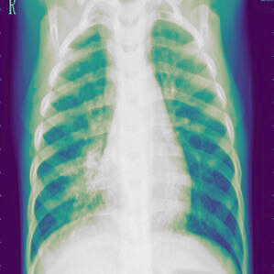
INTRODUCTION
The global burden of lung diseases like COVID 19, Pneumonia, and Tuberculosis is high, especially in poorer nations, creating a critical need for accessible and accurate diagnostic tools.
Chest X rays are a common initial assessment method, but their interpretation requires expertise, leading to interest in automated analysis using deep learning (DL) for improved consistency.
Previous research has limitations, often focusing on single architectures or unbalanced datasets, necessitating a systematic comparison of multiple DL approaches on a balanced, multi class dataset.
This study provides a thorough investigation by training and evaluating four primary modeling strategies on a balanced dataset of chest X rays (COVID 19, Normal, Pneumonia, Tuberculosis).
The compared approaches include: a custom CNN, transfer learning with pre trained models (MobileNet, EfficientNet, ResNet, Xception), an attention augmented EfficientNet, and an ensemble method.
The main goal is to examine the impact of these architectural choices on classification accuracy and reliability, with results demonstrating the strong potential of ensemble and attention based methods to enhance diagnostic performance for automated lung disease detection.

Slide 4
NOVELTY
Systematic & Unified Comparative Framework: Unlike many studies that evaluate a single model or a narrow set, this project's core novelty lies in its structured, head to head comparison of four distinct deep learning paradigms (Custom CNN, Multiple Transfer Learning models, a Hybrid Attention model, and an Ensemble) under identical conditions (same dataset, split, preprocessing, and metrics). This provides clear, actionable insights into which architectural strategy is best suited for this specific task.
Integration of an Attention Augmented Hybrid Model: While attention mechanisms are known, their integration into a comparative framework for this specific multi class medical problem is a significant contribution. This model aims to improve diagnostic accuracy and interpretability by forcing the network to focus on clinically relevant lung regions, a step beyond standard classification networks.
Strategic Ensemble of Heterogeneous Models: The ensemble approach is novel in its design to combine the strengths of fundamentally different architectures (e.g., the efficiency of MobileNet with the high accuracy of EfficientNet). This is more advanced than simply ensembling similar models and is aimed at creating a more robust and generalizable "meta model."
Comprehensive Multi Class Focus: The project addresses a critical gap by deliberately including Tuberculosis (TB) alongside COVID 19, Pneumonia, and Normal cases. Many contemporary studies focus only on COVID 19 and pneumonia, neglecting TB, which remains a major global health burden. This makes the project's scope more clinically comprehensive and globally relevant.

Slide 5
REAL TIME USAGE & APPLICATIONS
Primary Care & Triage Screening Tool: The system could be deployed as a support tool in clinics, emergency departments, or rural health centers. A healthcare worker could upload a chest X ray, and the model would provide a rapid, preliminary classification, helping to prioritize urgent cases (e.g., suspected COVID 19 or severe pneumonia) for immediate radiologist review.
Telemedicine and Mobile Health (mHealth): The lightweight models (like MobileNet) are engineered for compatibility with mobile devices and edge computing. This enables usage in remote or underserved areas via a smartphone or tablet app, allowing community health workers to perform initial screenings and share results with specialists in distant hospitals.
Radiology Workflow Augmentation: Integrated into a hospital's Picture Archiving and Communication System (PACS), the model could act as a pre reporting assistant. It would automatically analyze incoming X rays, flagging abnormal cases and suggesting potential diagnoses, thereby increasing radiologists' efficiency and reducing reporting turnaround times.
Mass Screening in Public Health Crises: During outbreaks (e.g., a pandemic or TB surge), the system could be used for high throughput screening of chest X rays in isolation camps, airports, or community centers, aiding in the rapid identification and isolation of potential cases.

Slide 6
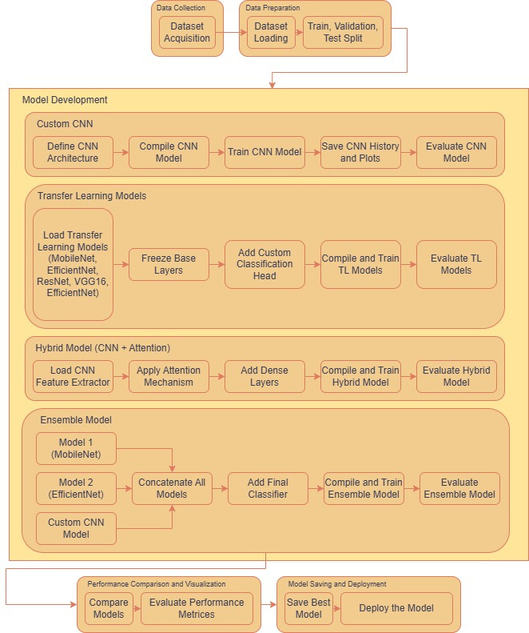
ARCHITECTURE DIAGRAM
This framework outlines a systematic pipeline for developing and comparing multiple deep learning models to classify chest X ray images into four disease categories: COVID 19, Normal, Pneumonia, and Tuberculosis. The process flows from data acquisition through multiple model development strategies, culminating in a performance comparison to select the best model for deployment.

Slide 7
MODULE WISE DESCRIPTION
1. Data Collection
Purpose: To gather the foundational image dataset required for training and evaluating the models.
Key Activity:
Dataset Acquisition: Sourcing a balanced and annotated dataset of chest X ray images. The dataset is specifically curated to contain four classes, ensuring a robust multi class classification challenge.

Slide 8
MODULE WISE DESCRIPTION
2. Data Preparation
Purpose: To load and structure the data for the machine learning pipeline.
Key Activities:
Dataset Loading: Reading the image files from storage and associating them with their correct class labels.
Train, Validation, Test Split: Dividing the dataset into three distinct subsets:
Training Set: Used to train the model's parameters.
Validation Set: Used during training to tune hyperparameters and monitor for overfitting.
Test Set: A held out set used only once for the final, unbiased evaluation of model performance.

Slide 9
MODULE WISE DESCRIPTION
3. Model Development
This is the core section where four distinct modeling strategies are implemented in parallel.
A. Custom CNN
Purpose: To build and train a convolutional neural network from scratch, tailored specifically for this task.
Workflow:
Define CNN Architecture: Manually design the network layers (convolutional, pooling, dropout, fully connected).
Compile CNN Model: Configure the model with an optimizer (e.g., Adam), a loss function (e.g., categorical cross entropy), and evaluation metrics (e.g., accuracy).
Train CNN Model: Fit the model to the training data over multiple epochs.
Save CNN History and Plots: Record training/validation metrics and generate graphs (like accuracy/loss curves) for analysis.
Evaluate CNN Model: Test the final trained model on the unseen test set.

Slide 10
MODULE WISE DESCRIPTION
B. Transfer Learning Models
Purpose: To leverage powerful, pre trained models and adapt them for the lung disease classification task, saving time and computational resources.
Workflow:
Load Pre trained Models: Import established architectures (MobileNet, EfficientNet, ResNet.
Freeze Base Layers: Keep the early, feature extraction layers of the pre trained model frozen to retain their learned general image knowledge.
Add Custom Classification Head: Remove the original top classification layer and add new, trainable dense layers leading to a 4 class output.
Compile and Train TL Models: Compile the new hybrid model and train it, allowing only the new head to learn from the medical images.
Evaluate TL Models: Assess the performance of each fine tuned model on the test set.

Slide 11
MODULE WISE DESCRIPTION
C. Hybrid Model (CNN + Attention)
Purpose: To enhance a standard CNN (often a transfer learning backbone) with an attention mechanism, forcing the model to focus on the most diagnostically relevant parts of the X ray image.
Workflow:
Load CNN Feature Extractor: Use a pre trained CNN (e.g., EfficientNet) as a backbone to extract feature maps.
Apply Attention Mechanism: Implement an attention layer that learns to weight the importance of different feature channels or spatial regions.
Add Dense Layers: Attach fully connected layers after the attention weighted features for final classification.
Compile and Train Hybrid Model: Train this integrated architecture end to end.
Evaluate Hybrid Model: Measure its classification performance.

Slide 12
MODULE WISE DESCRIPTION
D. Ensemble Model
Purpose: To combine the strengths of multiple high performing individual models to create a more robust and accurate "meta model."
Workflow:
Select Base Models: Choose the best performing models from previous stages (e.g., MobileNet, EfficientNet) as ensemble members.
Concatenate All Models: Merge the outputs (penultimate layer features or predictions) from each base model.
Add Final Classifier: Attach a new classifier (e.g., a dense layer) that learns from this combined, richer set of features.
Compile and Train Ensemble Model: Train the final classifier layer, often while keeping the base models frozen.
Evaluate Ensemble Model: Test the combined model's performance.

Slide 13
MODULE WISE DESCRIPTION
4. Performance Comparison and Visualization
Purpose: To analyze all developed models and select the optimal one for real world use.
Key Activities:
Compare Models: Systematically compare all models (Custom CNN, TL models, Hybrid, Ensemble) using standardized metrics.
Evaluate Performance Metrics: Calculate and review key metrics such as Accuracy, Precision, Recall, F1 Score, and confusion matrices for each class.
Save Best Model: Identify the model with the best and most consistent performance on the validation/test sets and save its architecture and weights.
Deploy the Model: Prepare the selected best model for integration into a clinical or screening application, such as a web service or mobile app.

Slide 14
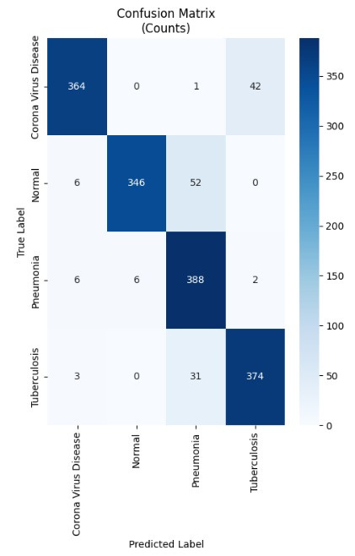
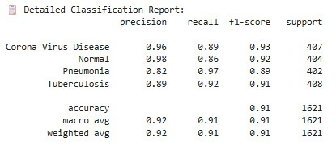
RESULTS AND DISCUSSION
CUSTOM CNN

Slide 15
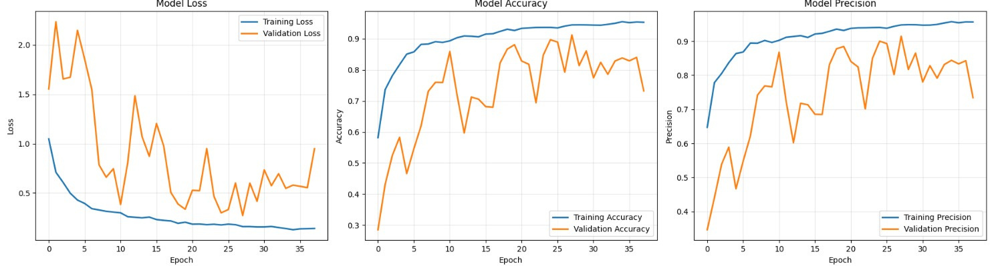
RESULTS AND DISCUSSION
CUSTOM CNN

Slide 16
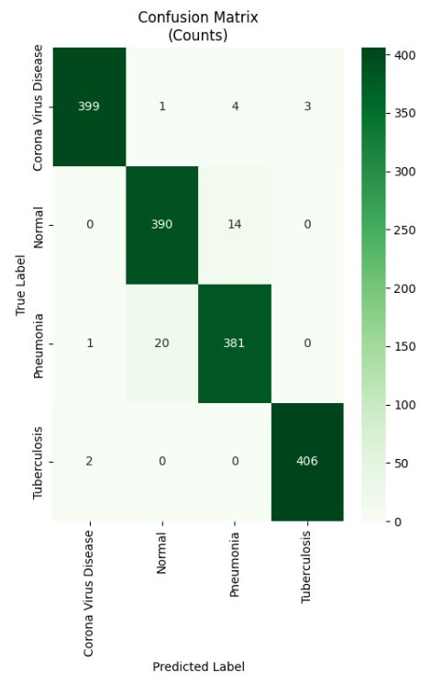
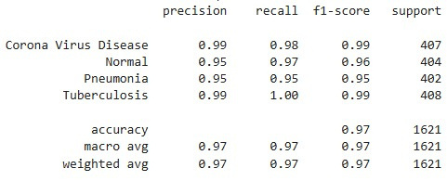
RESULTS AND DISCUSSION
MOBILE NET MODEL

Slide 17
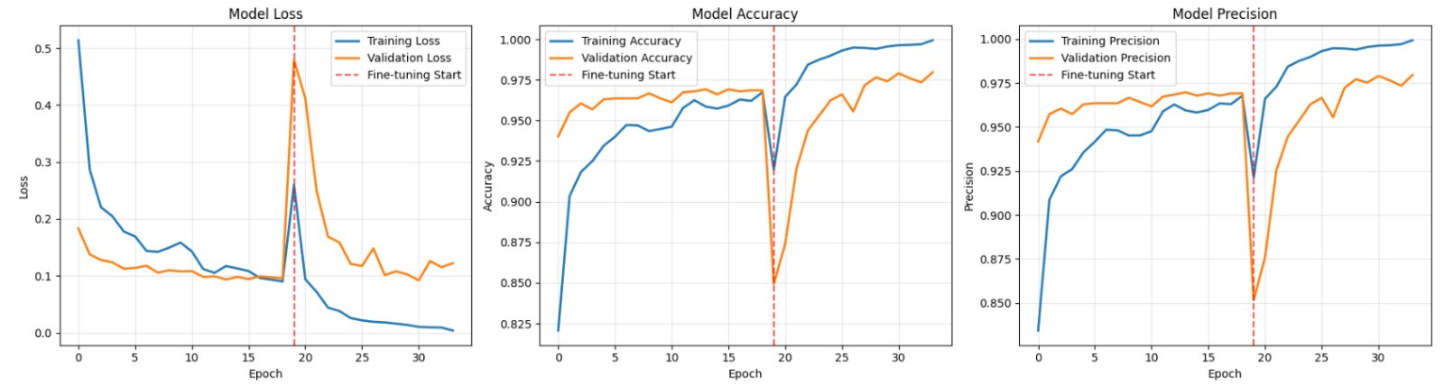
RESULTS AND DISCUSSION
MOBILE NET MODEL

Slide 18
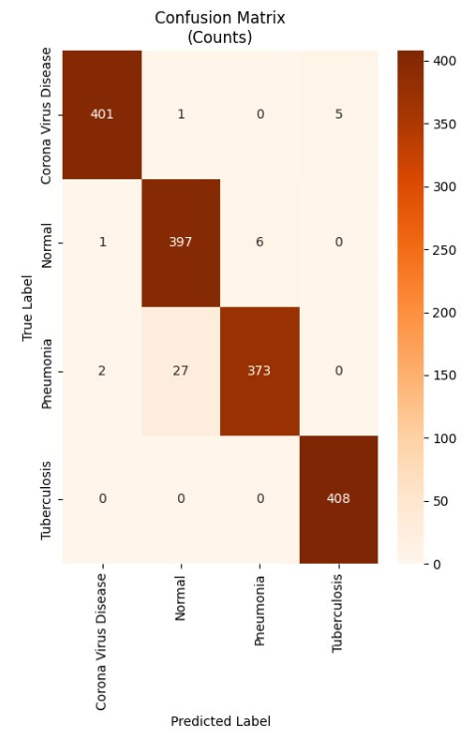
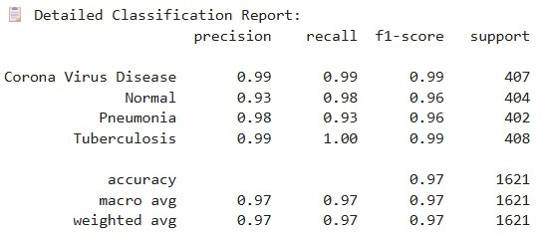
RESULTS AND DISCUSSION
EFFICIENT NET

Slide 19
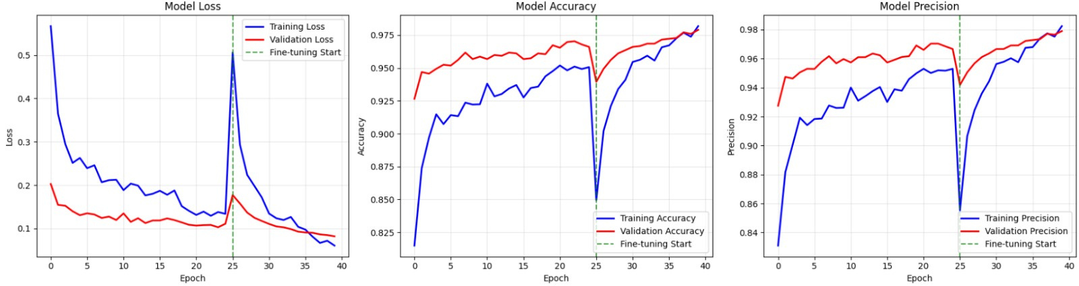
RESULTS AND DISCUSSION
EFFICIENT NET

Slide 20
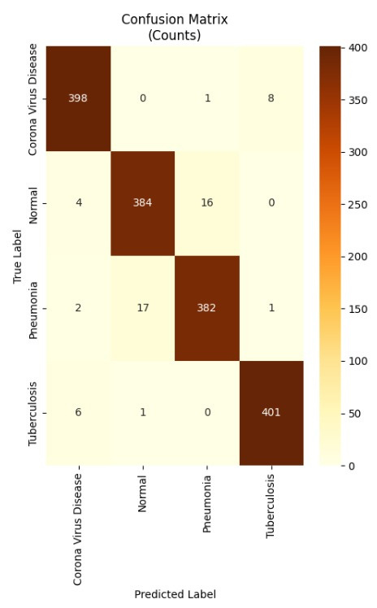
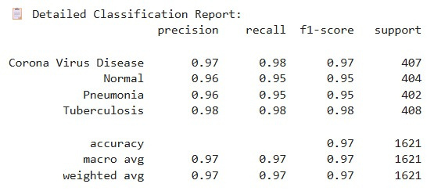
RESULTS AND DISCUSSION
XCEPTION MODEL

Slide 21
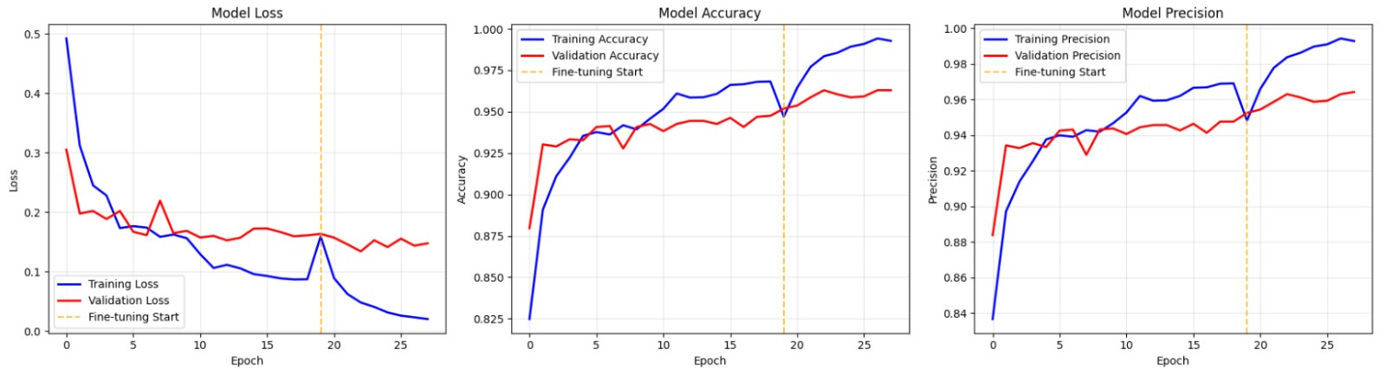
RESULTS AND DISCUSSION
XCEPTION MODEL

Slide 22
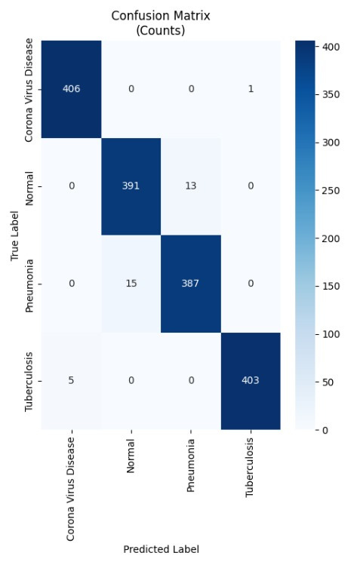
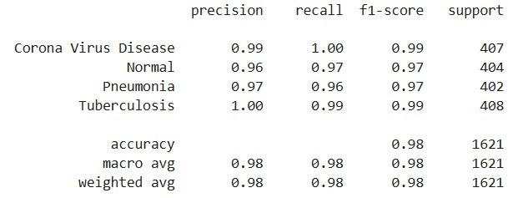
RESULTS AND DISCUSSION
RESNET MODEL

Slide 23
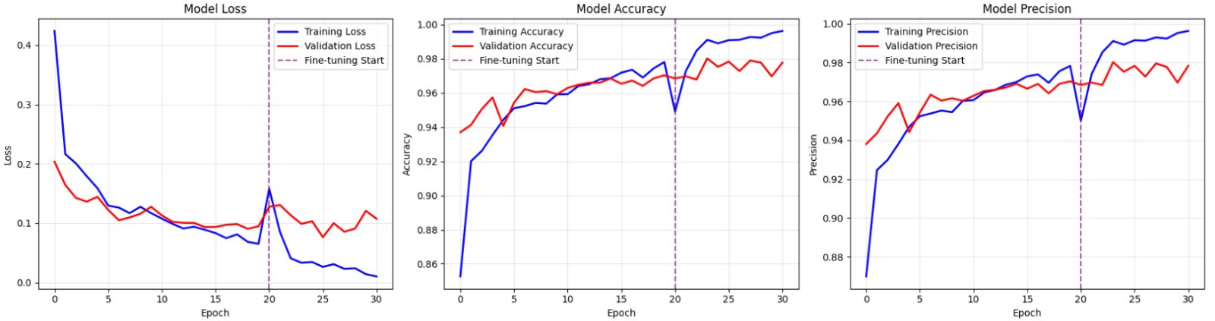
RESULTS AND DISCUSSION
RESNET MODEL

